Slide 1
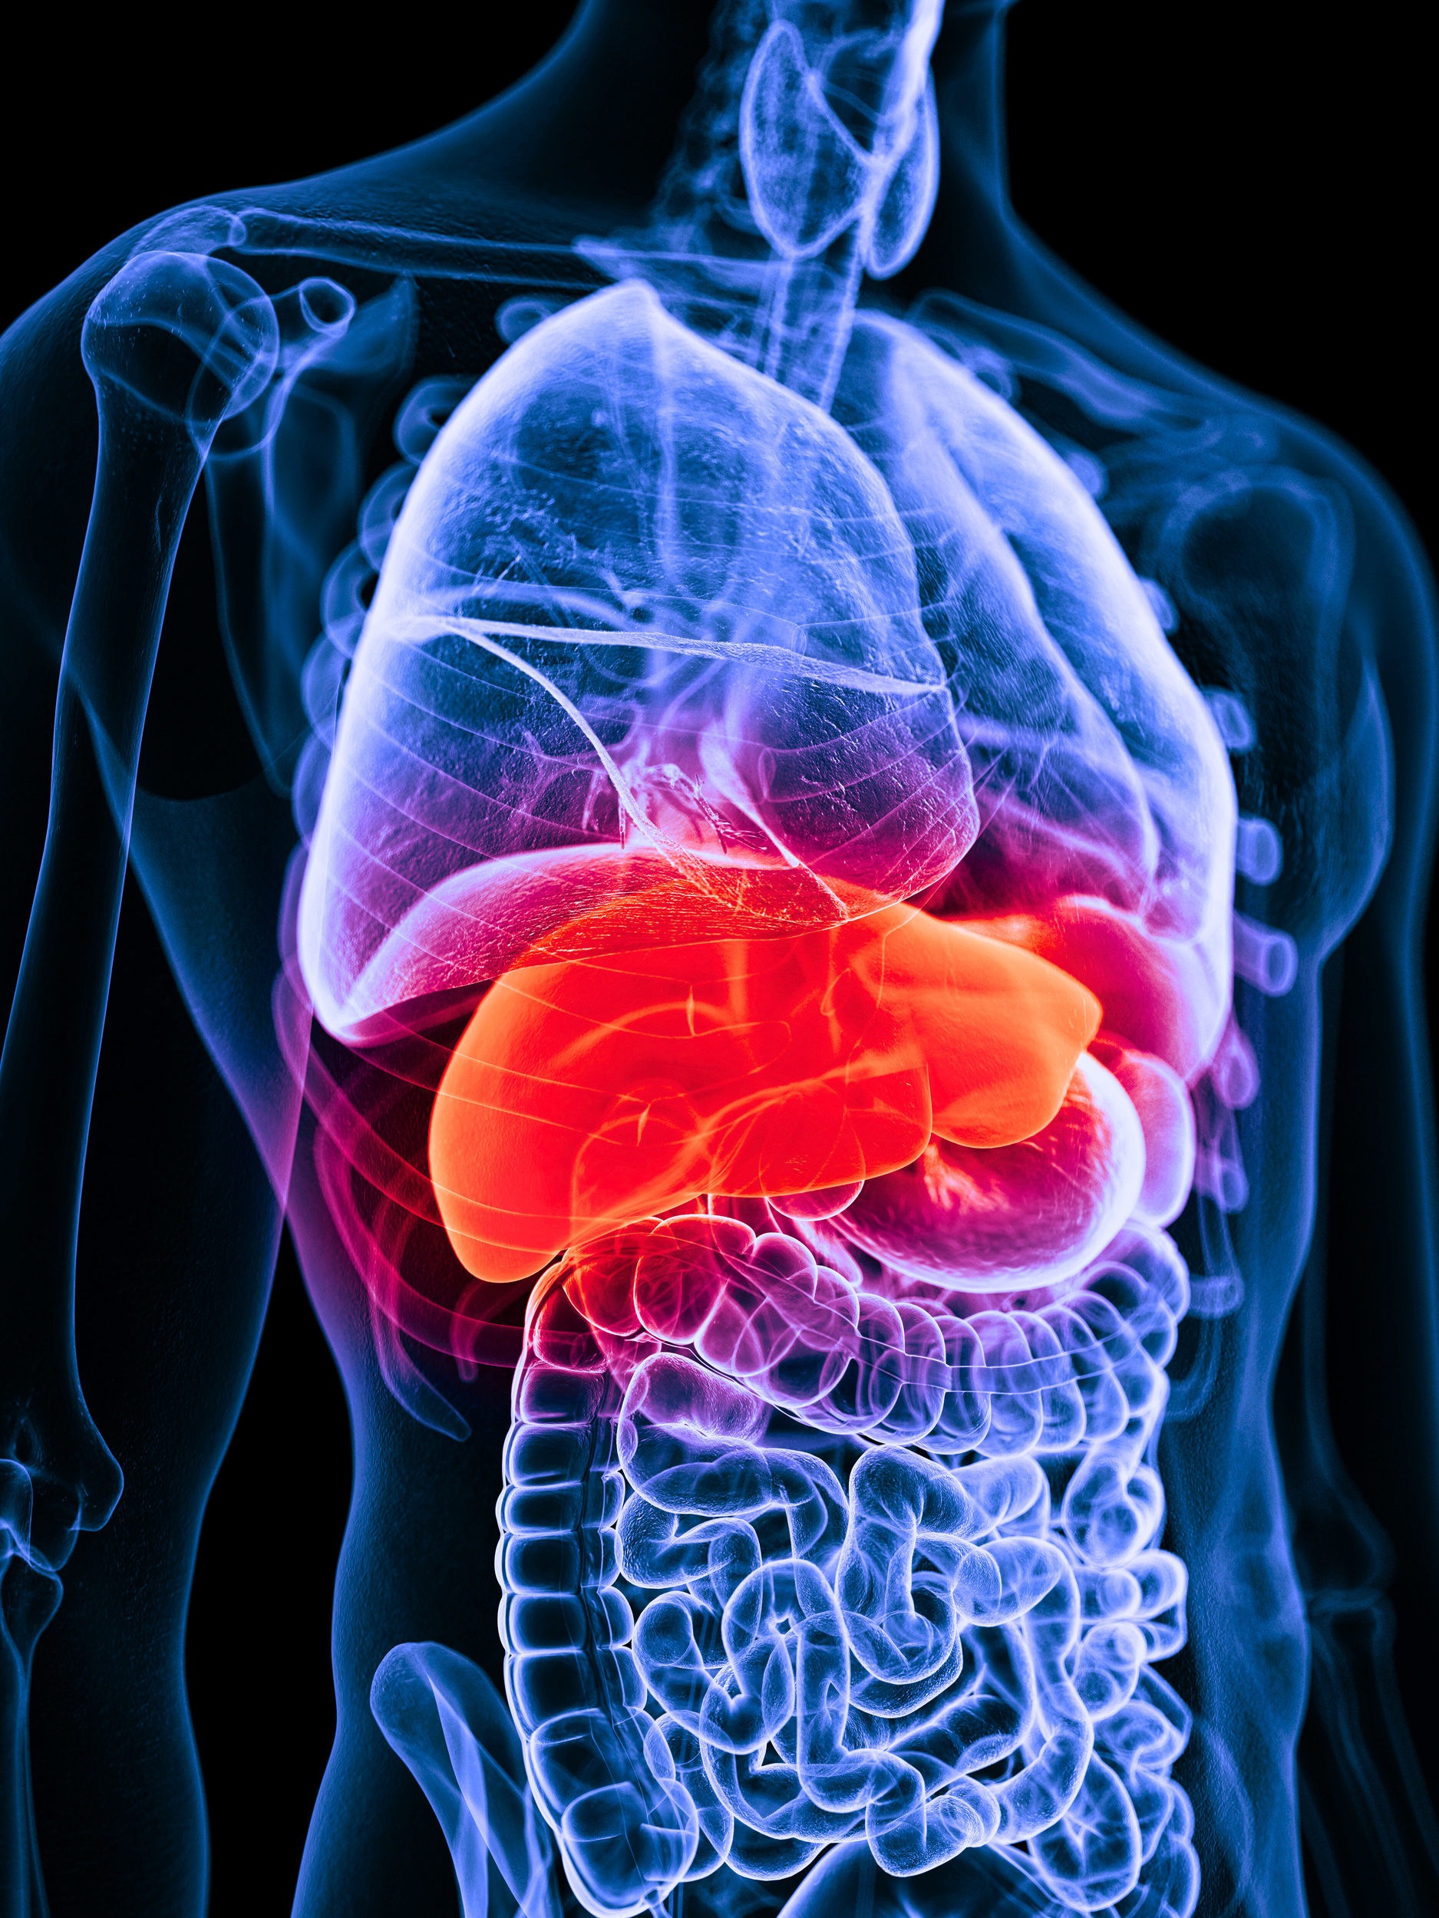



Tumor Rupture After Portal Vein Embolization
Junaid Raja, MD
Assistant Professor, Division of Interventional Radiology, University of Alabama
Bo Liu, MD
Interventional Radiologist
City of Hope National Medical Center
Batis Golestany, BS
University of California Riverside School of Medicine

Slide 2
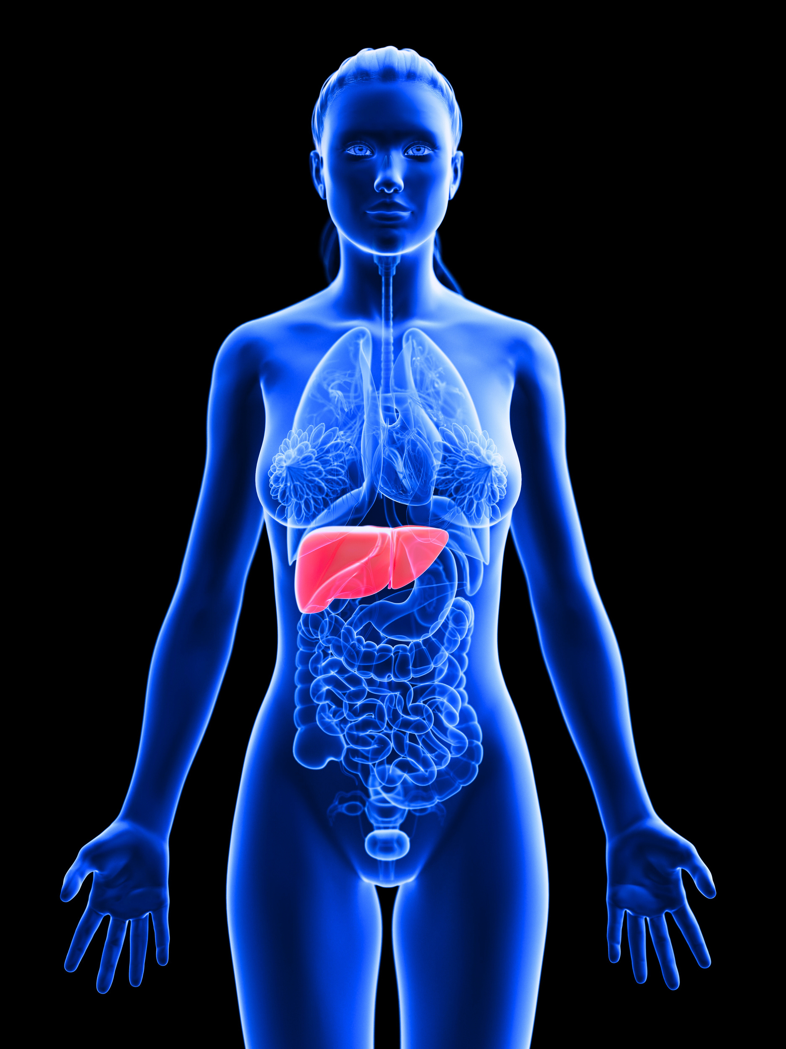
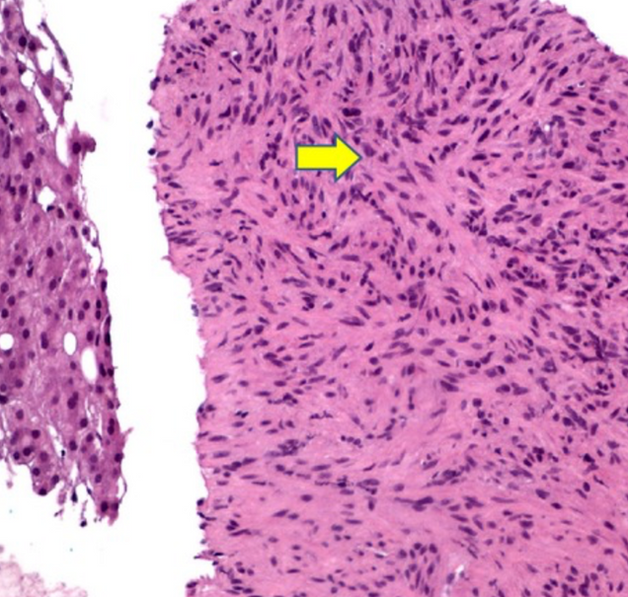
Clinical History
  62 y.o. male with spindle cell mass of the liver referred by hepatobiliary surgery for portal vein embolization prior to planned resection.
Chelimilla H, Badipatla K, Ihimoyan A, Niazi M. A rare occurrence of primary hepatic leiomyosarcoma associated with epstein barr virus infection in an AIDS patient. Case Rep Gastrointest Med. 2013;2013:691862. doi: 10.1155/2013/691862. Epub 2013 Aug 19. PMID: 24024048; PMCID: PMC3760271.

Slide 3
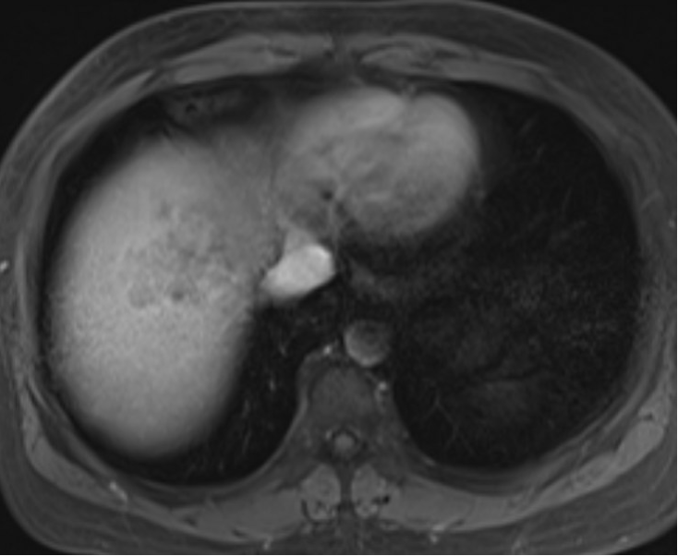
Initial Imaging

Slide 4
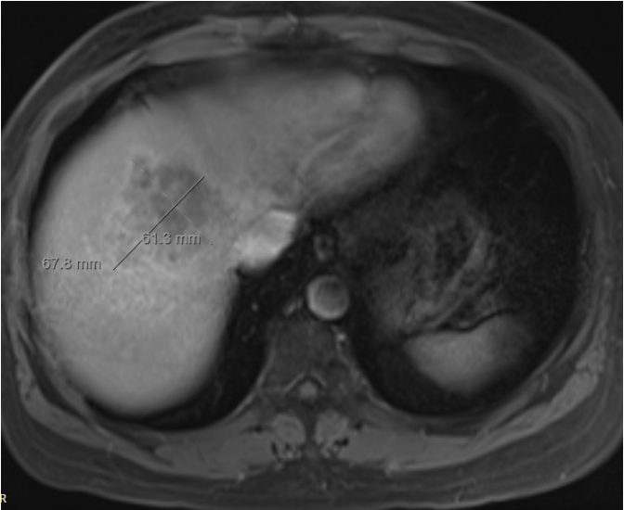
Initial Imaging

Slide 5
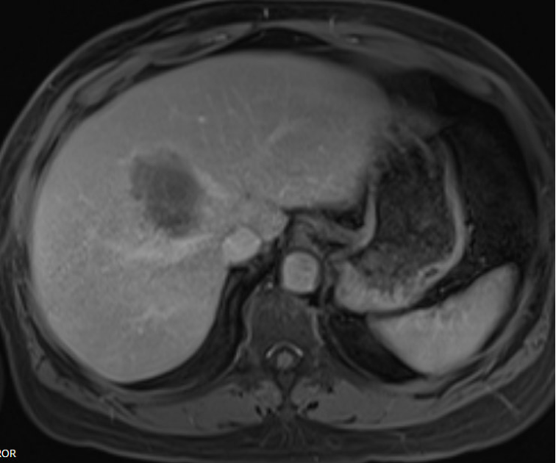
Initial Imaging

Slide 6
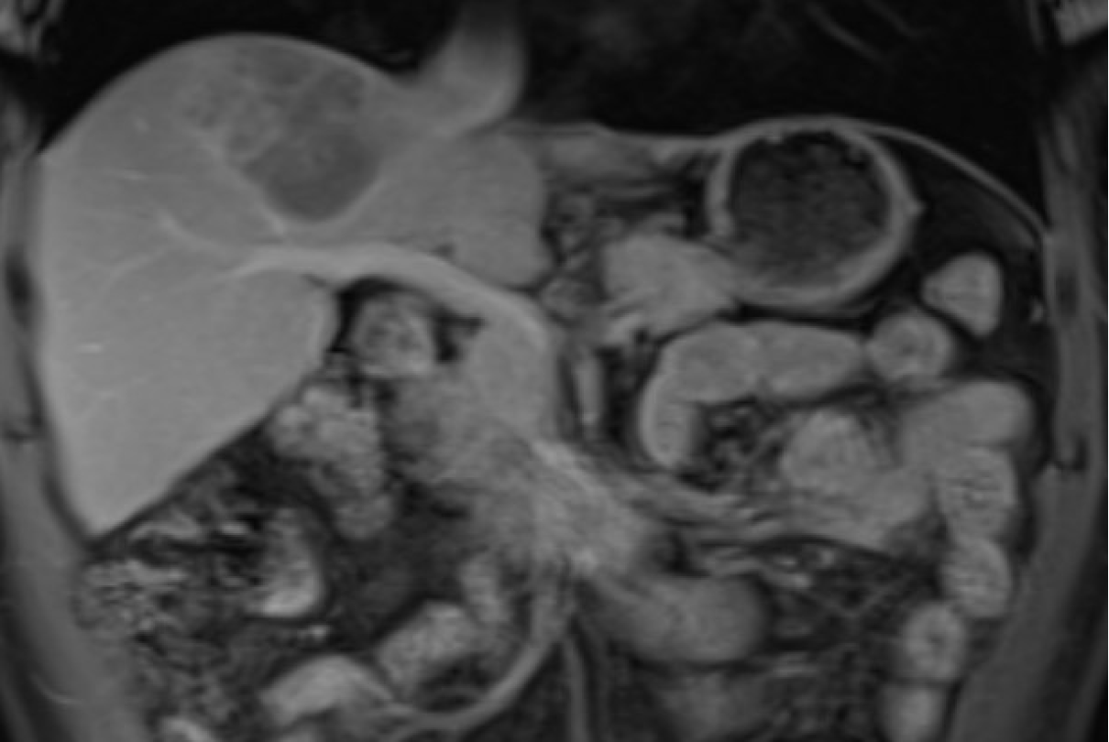
Initial Imaging

Slide 7
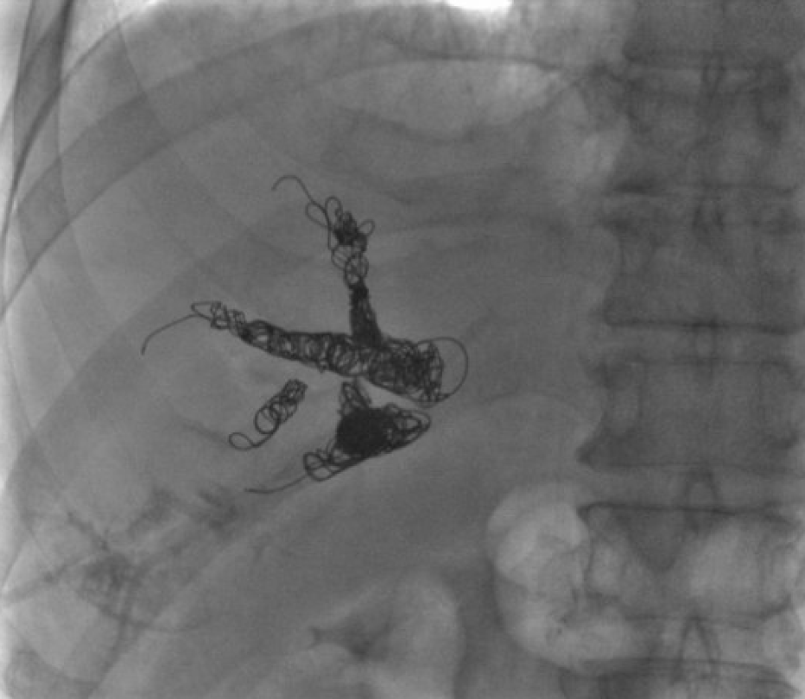
Portal Vein Embolization
Procedure:
  Right portal vein embolization was performed using 300-500 & 500-700 um Embospheres and Embold detachable coils

Slide 8
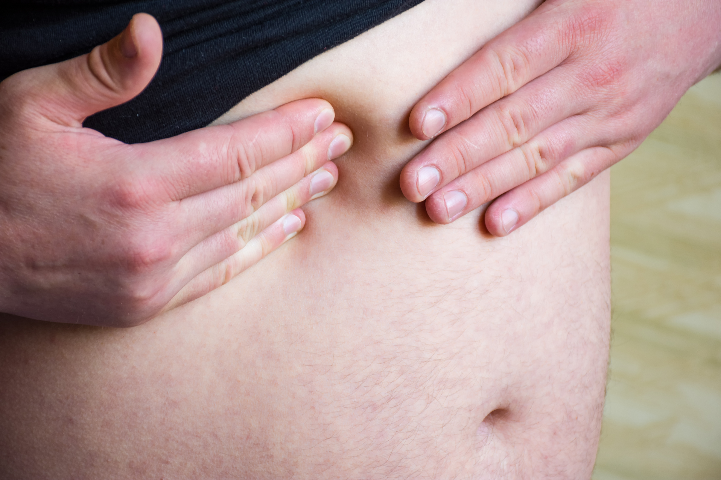
Patient Follow-up
Two weeks following uneventful PVE:
  Patient presented for severe 10/10 right upper quadrant abdominal pain radiating to the right shoulder
  CTA abdomen + pelvis was obtained urgently

Slide 9
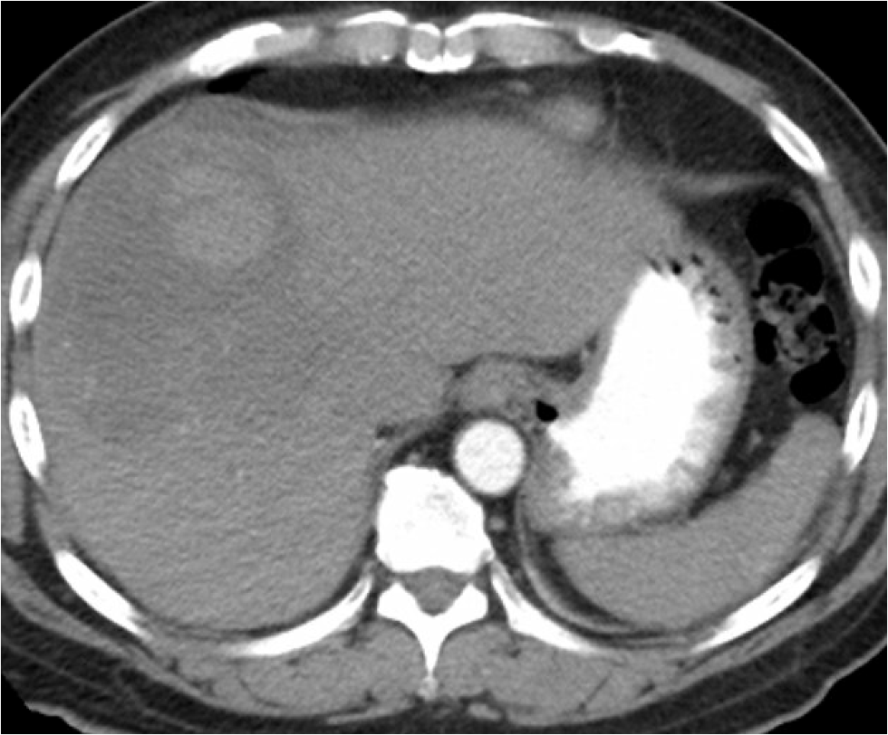
Follow-up Imaging

Slide 10
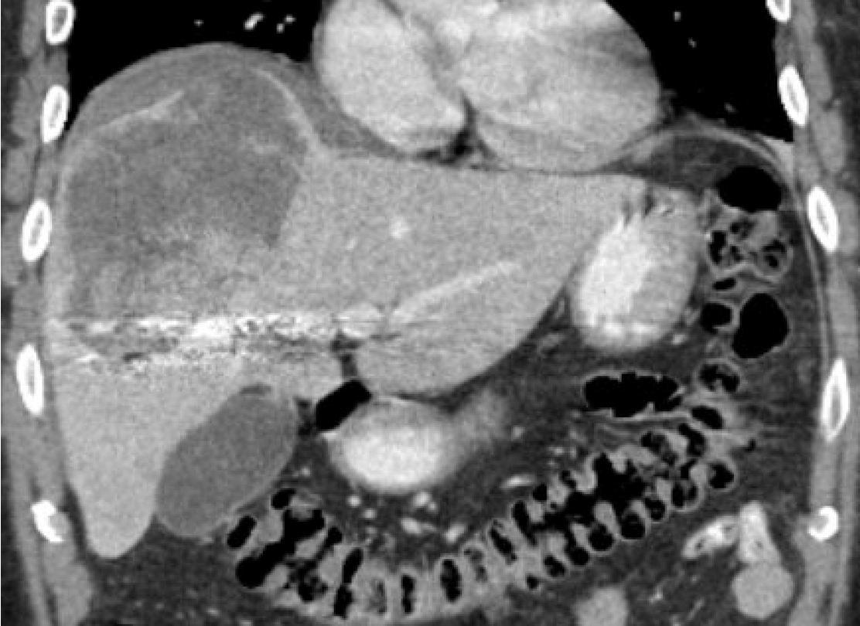
Follow-up Imaging

Slide 11
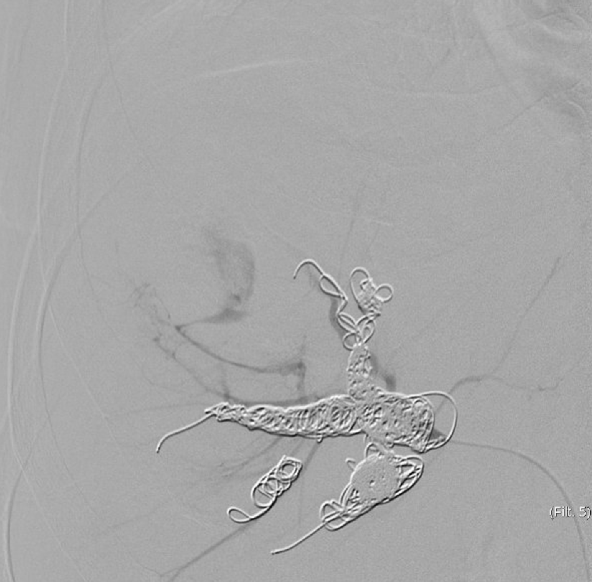
Follow-up Imaging

Slide 12
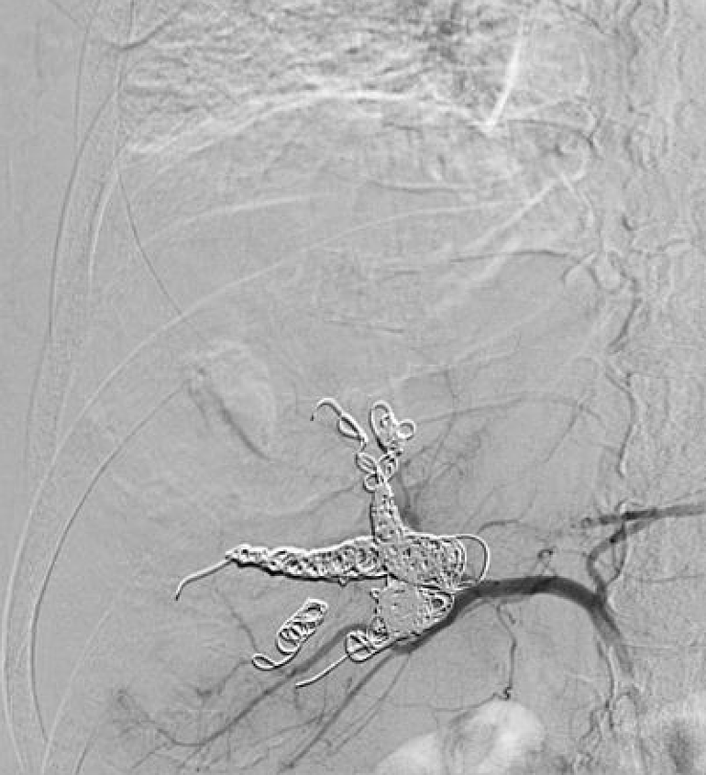
Follow-up Imaging

Slide 13
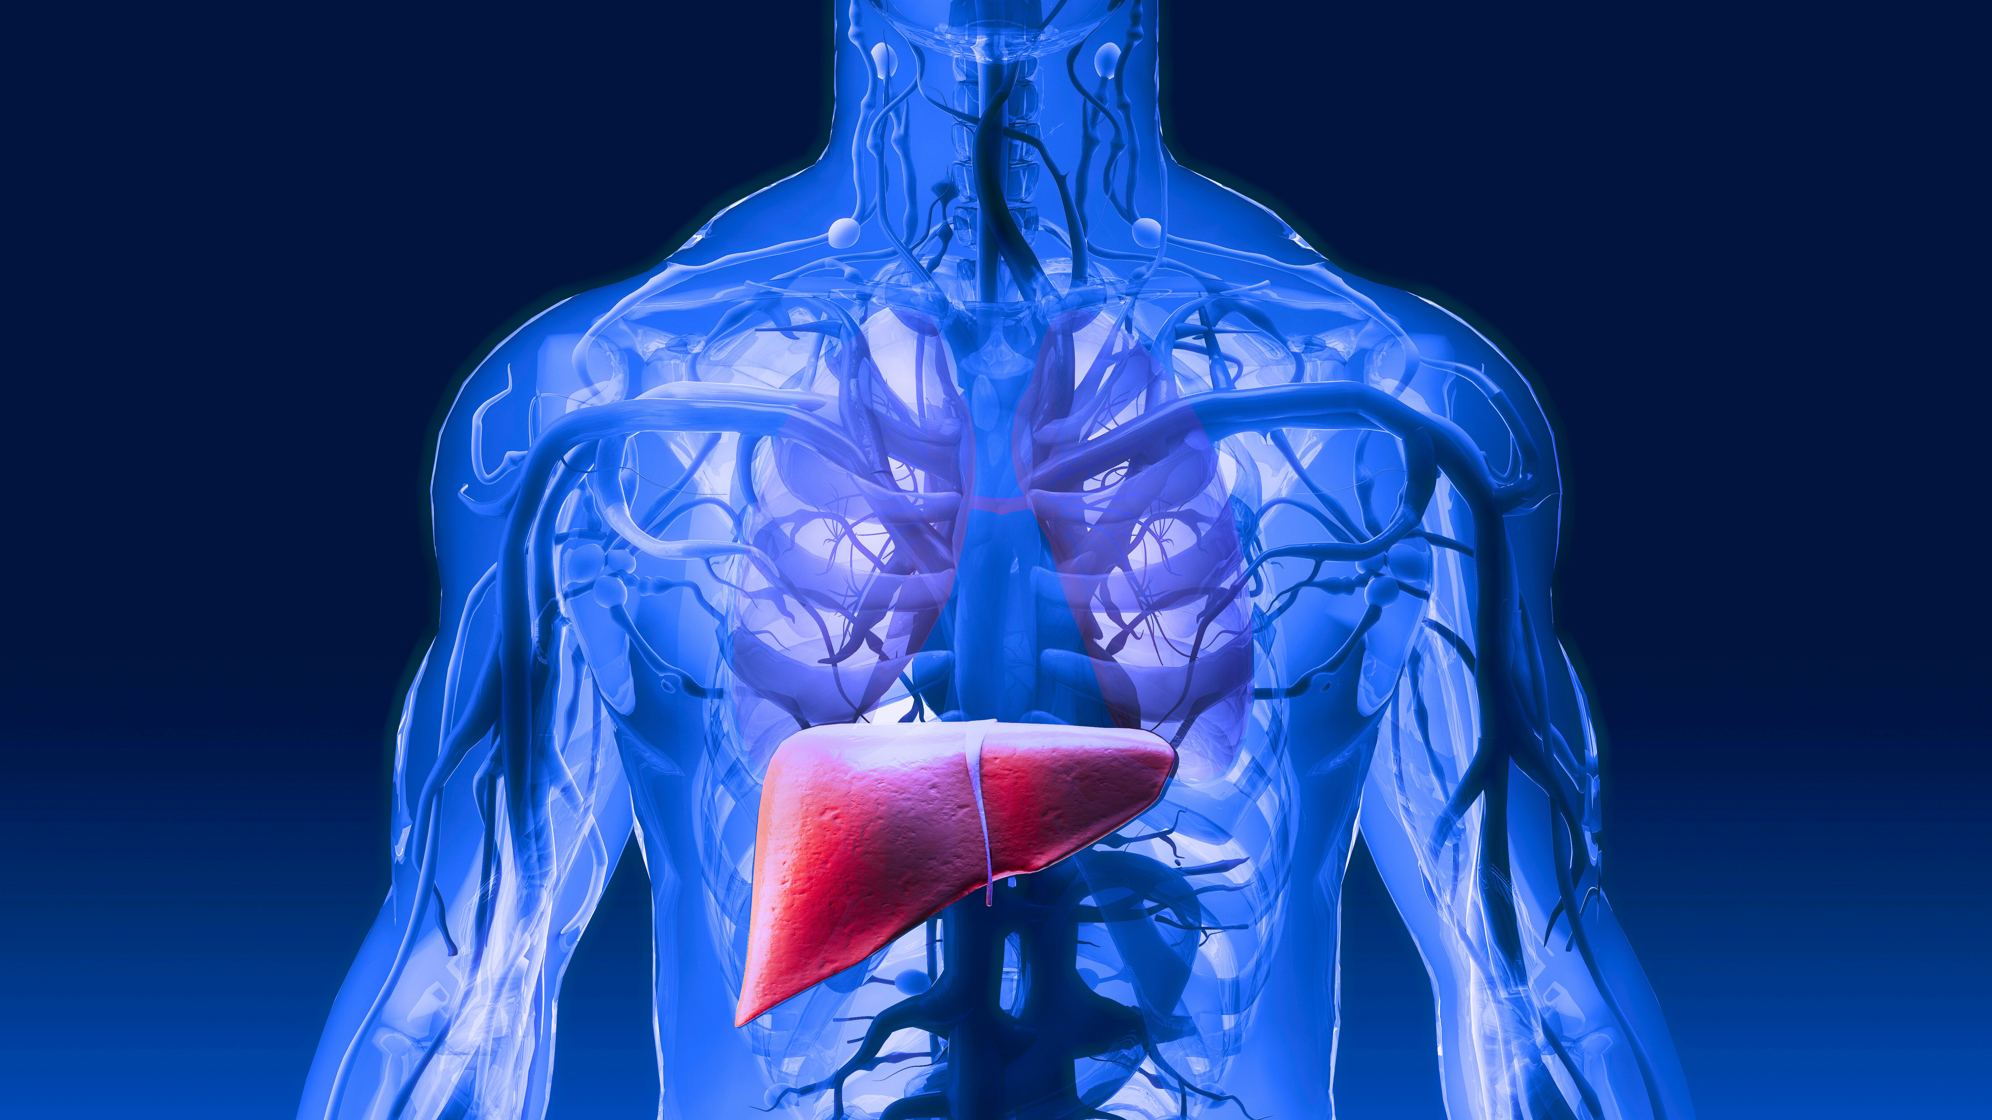
Clinical Outcome
  Tumor rupture with active hemorrhage successfully treated with transarterial embolization using 300-500 um Embospheres.
  Diagnostic laparoscopy with omental biopsy 1 month following discharge confirmed peritoneal carcinomatosis, excluding the patient from planned resection

Slide 14
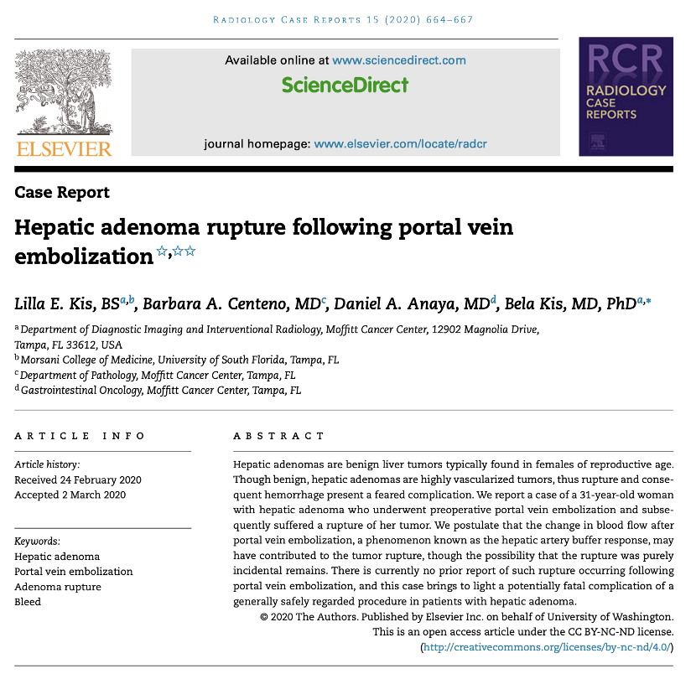
In the Literature
Prior Case Study:
  In this case, a benign hepatic adenoma ruptured in a 31 year-old woman s/p PVE
  The is the only other tumor rupture post PVE that has been established in the medical literature
Implications:
  Consider transarterial embolization before PVE for large, hypervascular tumors to reduce rupture risk

Slide 15
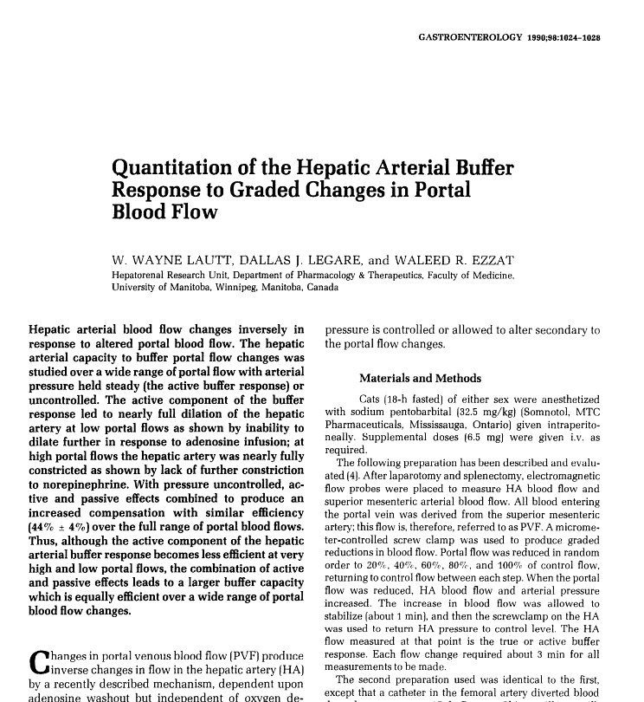
In the Literature
Key Findings:
  The hepatic arteries inversely adjust blood flow depending on portal blood flow
  Hepatic Artery Buffer Response: Increased arterial blood flow after Portal Vein Embolization (PVE) may lead to rupture in hypervascular tumors
Implications:
  This mechanism suggests mechanism by which PVE can lead to tumor rupture

Slide 16
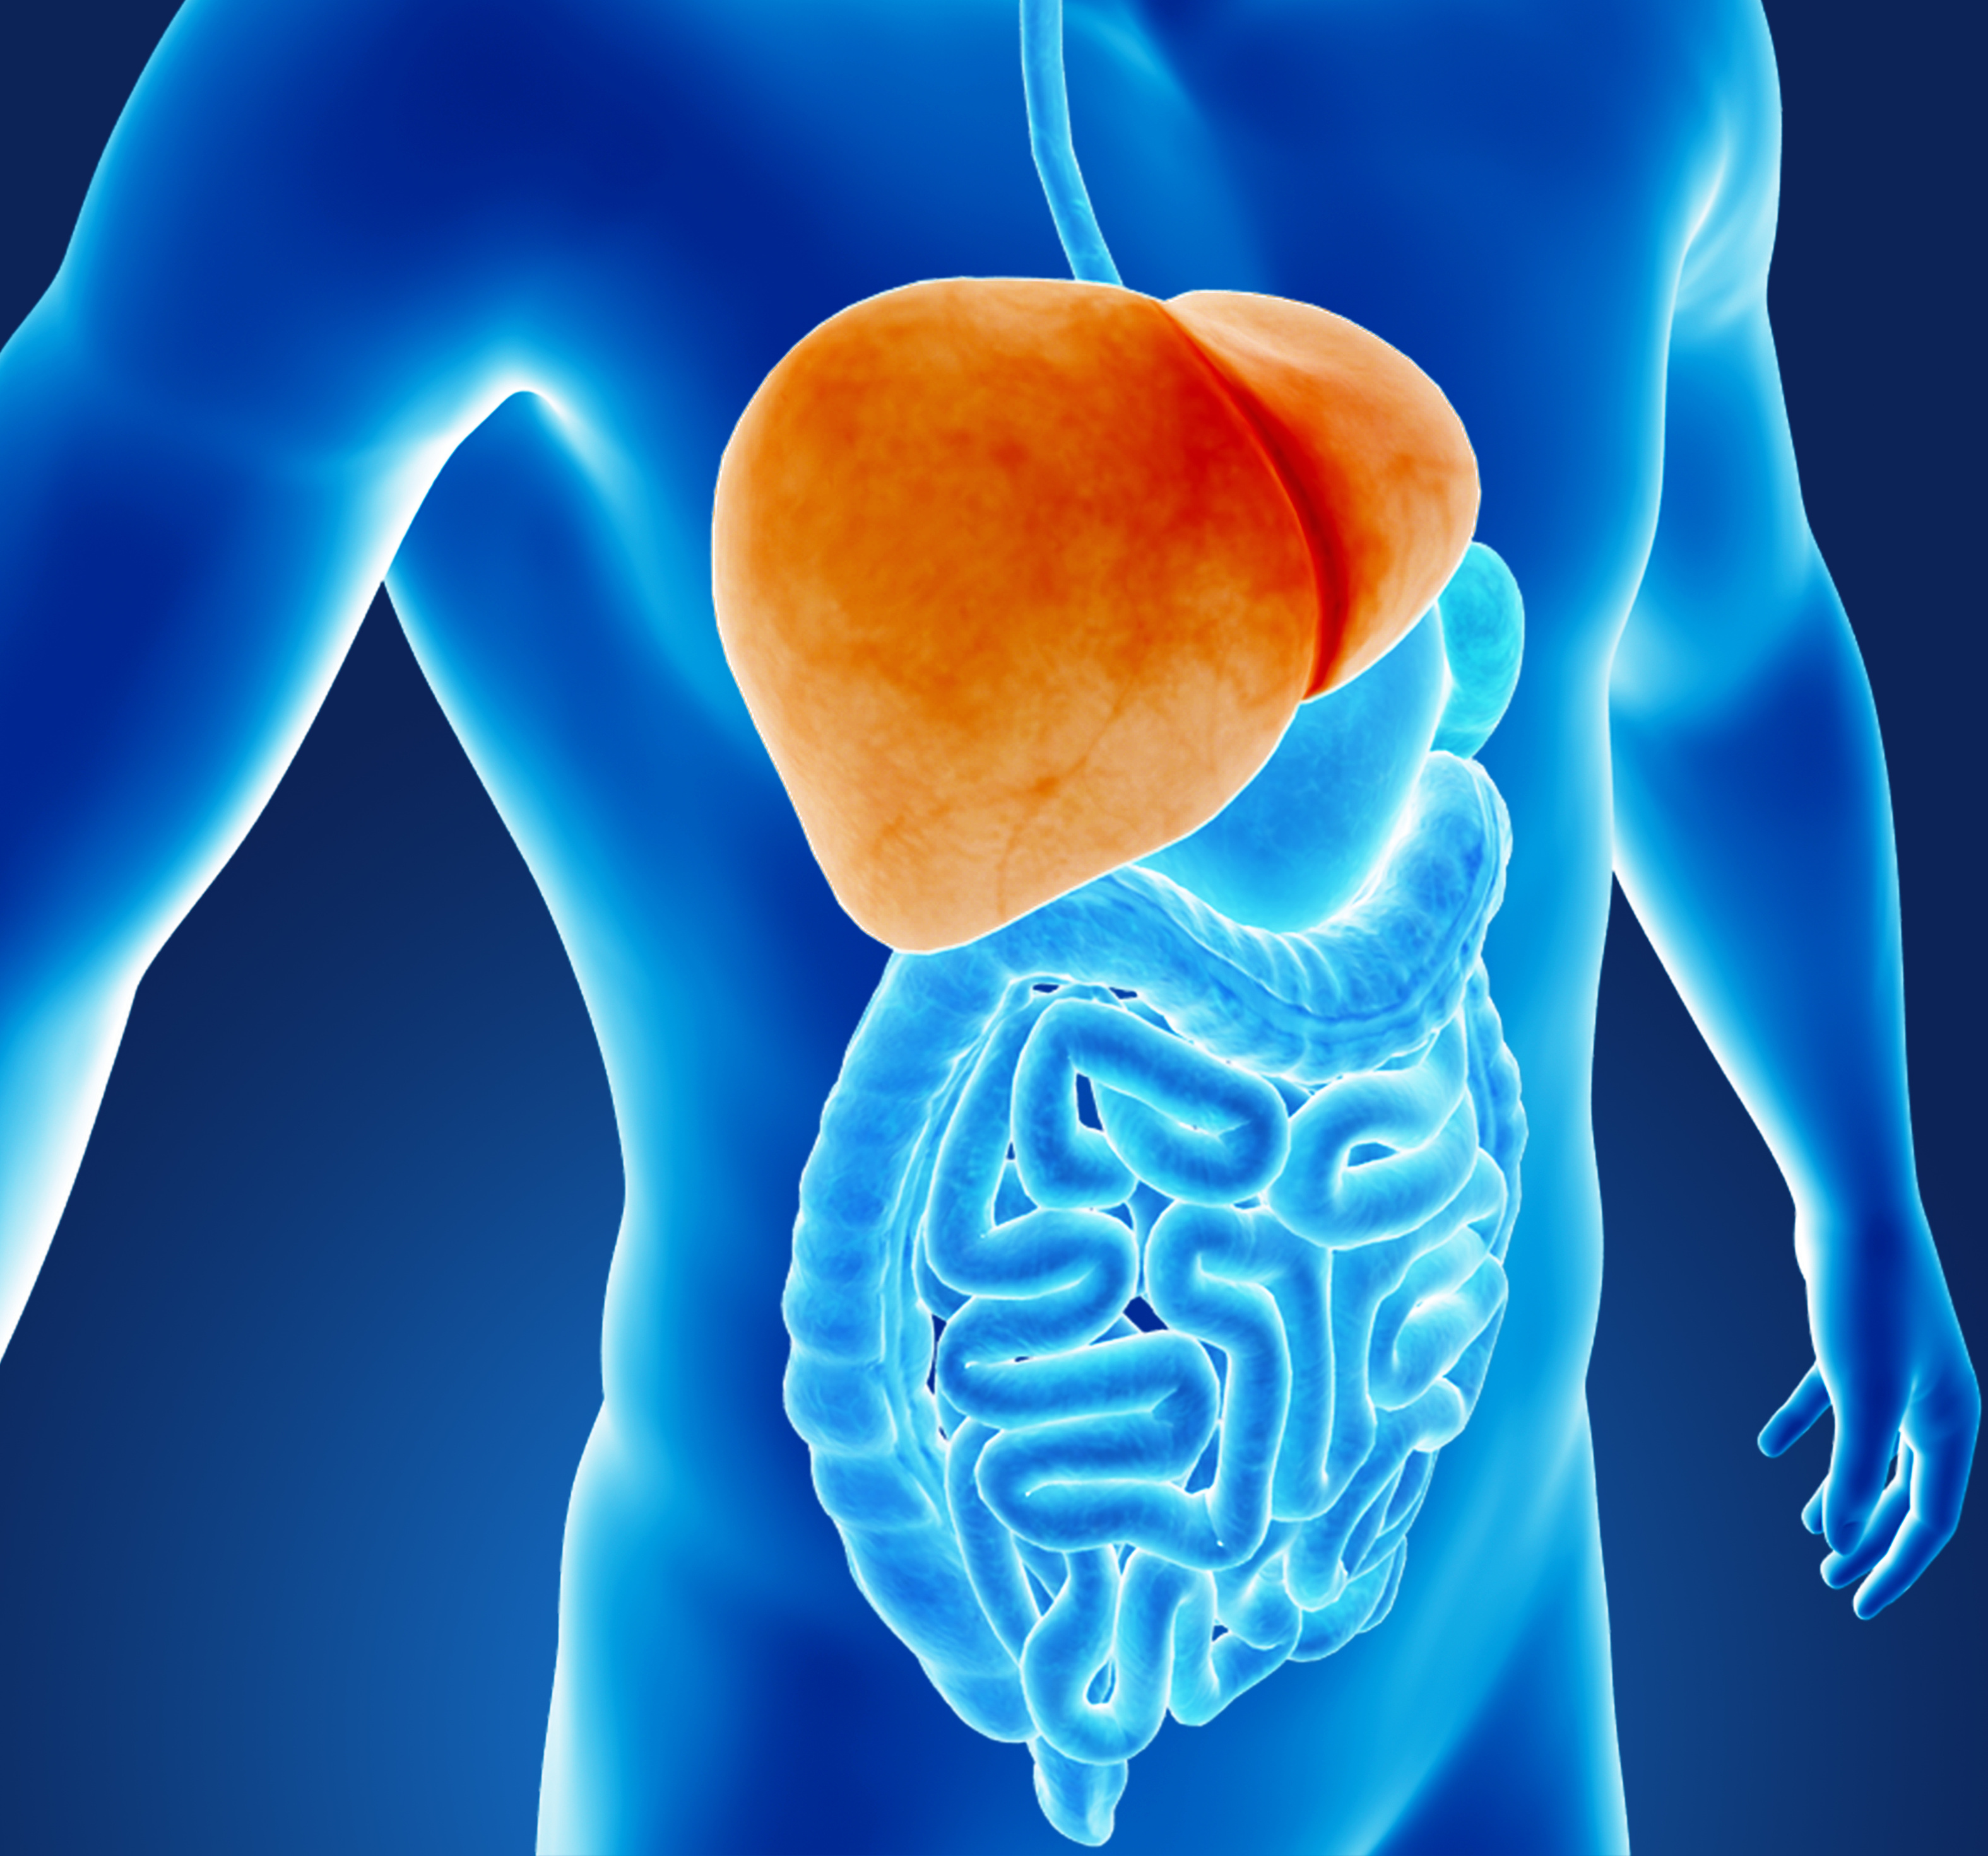
Future Best Practices
Recommendation:
  In patients with hypervascular tumors located in a subcapsular or exophytic position, consider Y90 radiation lobectomy instead of PVE to induce future liver remnant (FLR) hypertrophy and reduce risk of this potential complication.
  Consider discussion with the referring surgeon on a case-by-case basis.

Slide 17
References
Kis LE, Centeno BA, Anaya DA, Kis B. Hepatic adenoma rupture following portal vein embolization. Radiol Case Rep. 2020 Apr 5;15(6):664-667. doi: 10.1016/j.radcr.2020.03.002. PMID: 32280397; PMCID: PMC7136602.
Lautt WW, Legare DJ, Ezzat WR. Quantitation of the hepatic arterial buffer response to graded changes in portal blood flow. Gastroenterology. 1990 Apr;98(4):1024-8. doi: 10.1016/0016-5085(90)90029-z. PMID: 2311859.
Chelimilla H, Badipatla K, Ihimoyan A, Niazi M. A rare occurrence of primary hepatic leiomyosarcoma associated with epstein barr virus infection in an AIDS patient. Case Rep Gastrointest Med. 2013;2013:691862. doi: 10.1155/2013/691862. Epub 2013 Aug 19. PMID: 24024048; PMCID: PMC3760271.

